Slide 1


BULGARIAN ACADEMY OF SCIENCES: INSTITUTE OF BIODIVERSITY & ECOSYSTEM RESEARCH (IBER-BAS)
Department of
AQUATIC ECOSYSTEMS
Stuff (May 2014):
Professors 2
Associate Professors 2
Chief Assistants 12
Assistants 7
PhD 16+
Publications (2013/In press):
Articles int’l journals referred 23/17
Articles int’l IF journals 18/15
Conference Reports 24/30
Chapters in monographs 4/8
Textbooks for universities 2/-

Slide 2
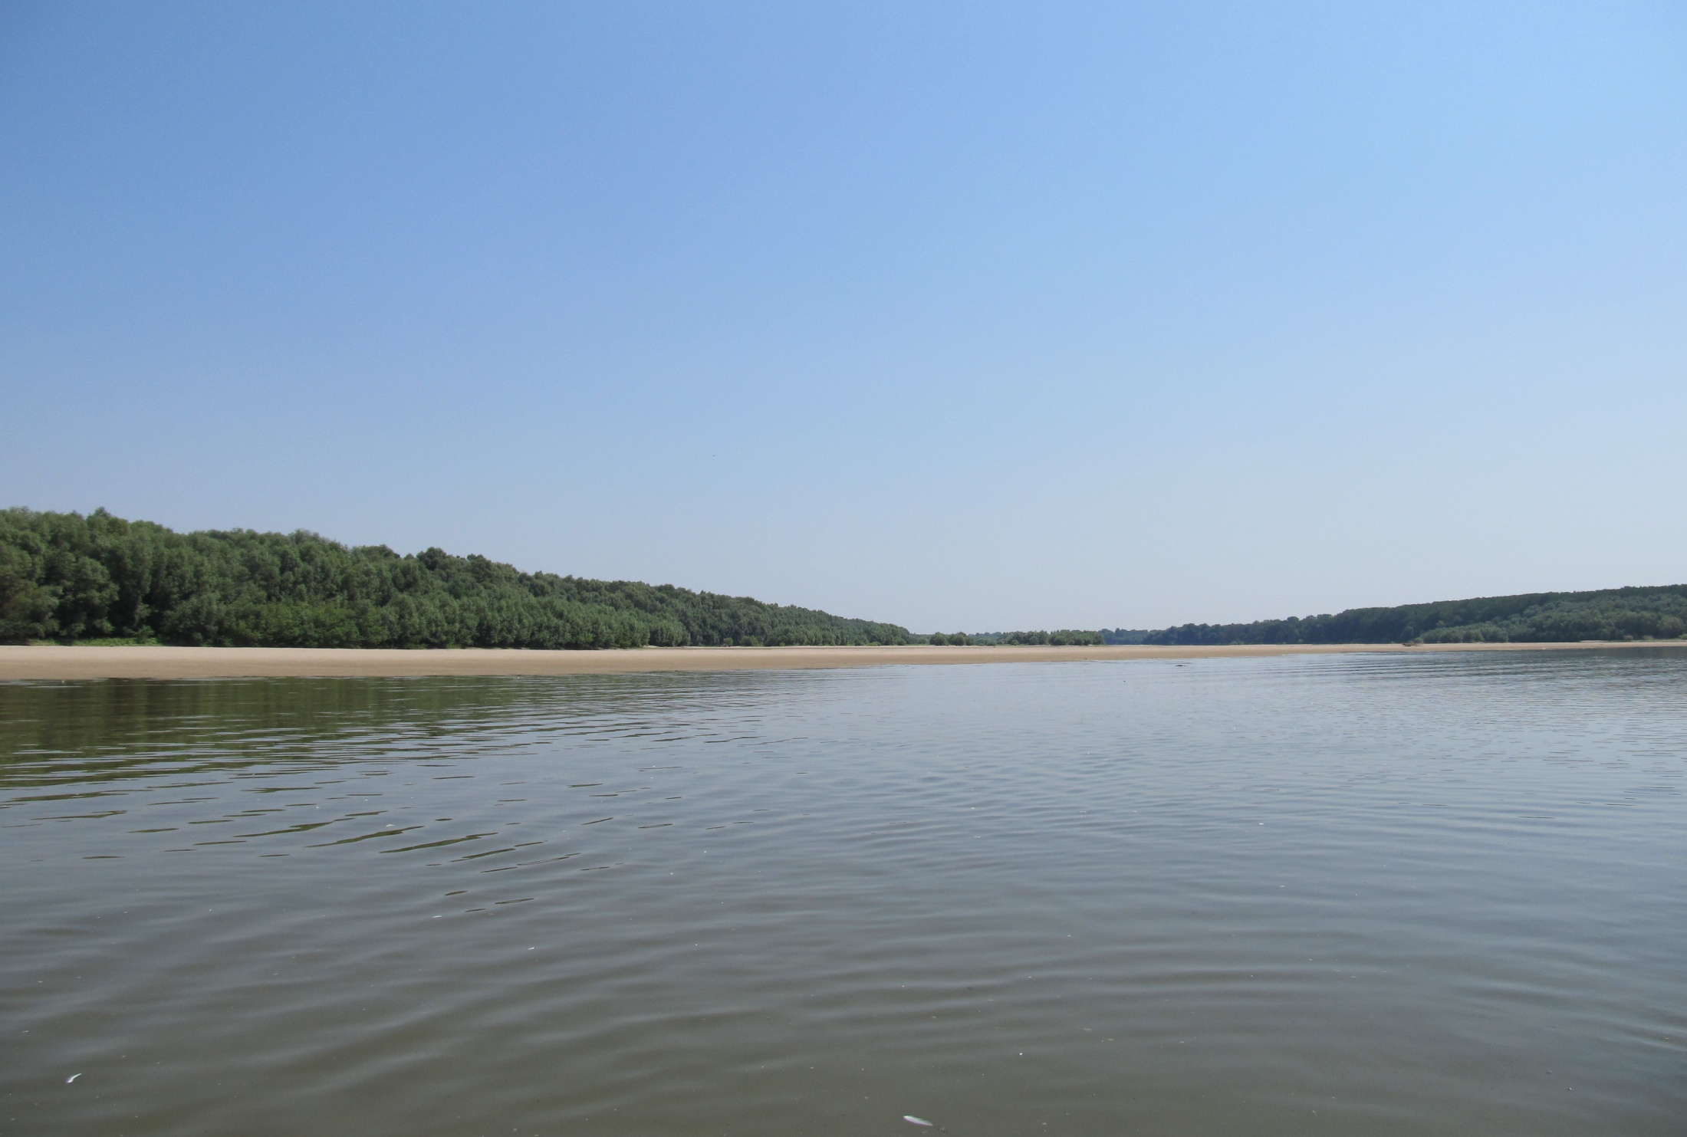
Established in July 2010 as a successor of the three former scientific bodies/sectors:
    Department of Hydrobiology (former Institute of Zoology),
    Department of Bio-Indication & Environmental Assessments, partly (former Central Lab of General Ecology), and
    Department of Functional Ecology + Lab of Marine Ecology, partly (former CLGE)
Research Priorities:
      Biology and ecology of surface water bodies;
      Biodiversity and aquatic ecosystems’ goods & services;
      Bio-indication and biomonitoring of water bodies;
      Methodology & practices of ecological classification and assessment of the human pressures/impacts on aquatic ecosystems/water bodies;
      Applied ecology & environmental impact assessments (EIA);
      Biodiversity & protection of aquatic species and habitats;
      Scientific and methodological support for the Integrated Water (Resources) Management
Photo: Mila Alexandrova

Slide 3
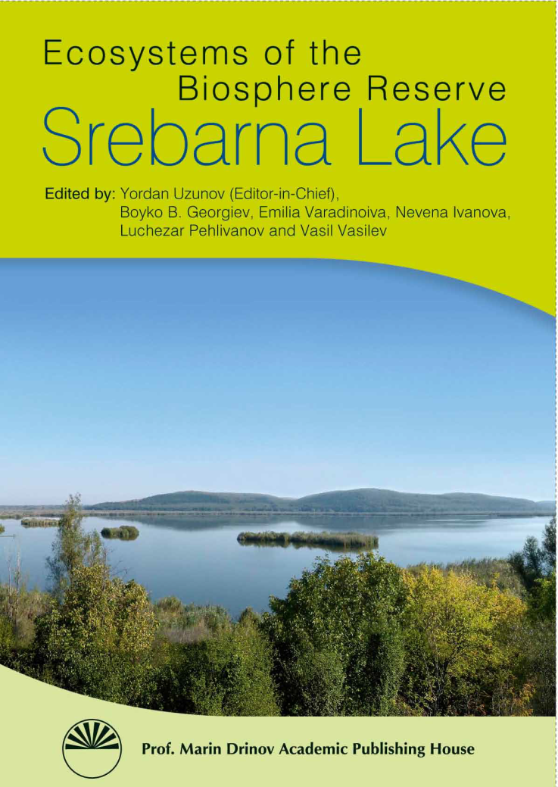
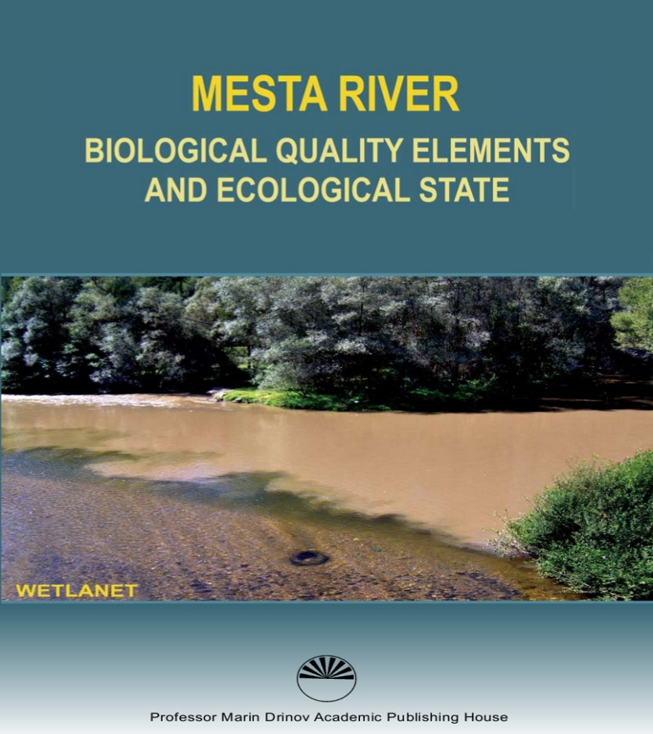
Division of Biological Diversity & Processes
in Freshwater Ecosystems
Research Groups
Lotic Ecosystems (rivers, brooks, channels, canals)
Lentic Ecosystems (lakes, reservoirs, swamps, marshes, lagoons,)
Environmental Microbiology
Research Priorities:
Methodology of ecological classification and assessment of human pressures and impacts on fresh-water ecosystems, introducing multihabitat & multi-metric approaches;
Biological indication and biomonitoring of freshwater bodies, incl. artificial and modified;
Biological productivity, trophic webs & cascades; key organisms/communities in lotic and lentic ecosystems within and along the Danube River;
Methods for assessment and risk management of aquatic invasive alien species;
Applied ecology and EIA of freshwater bodies;
Scientific and methodical support of Integrated Water Management with GIS applications.

Slide 4
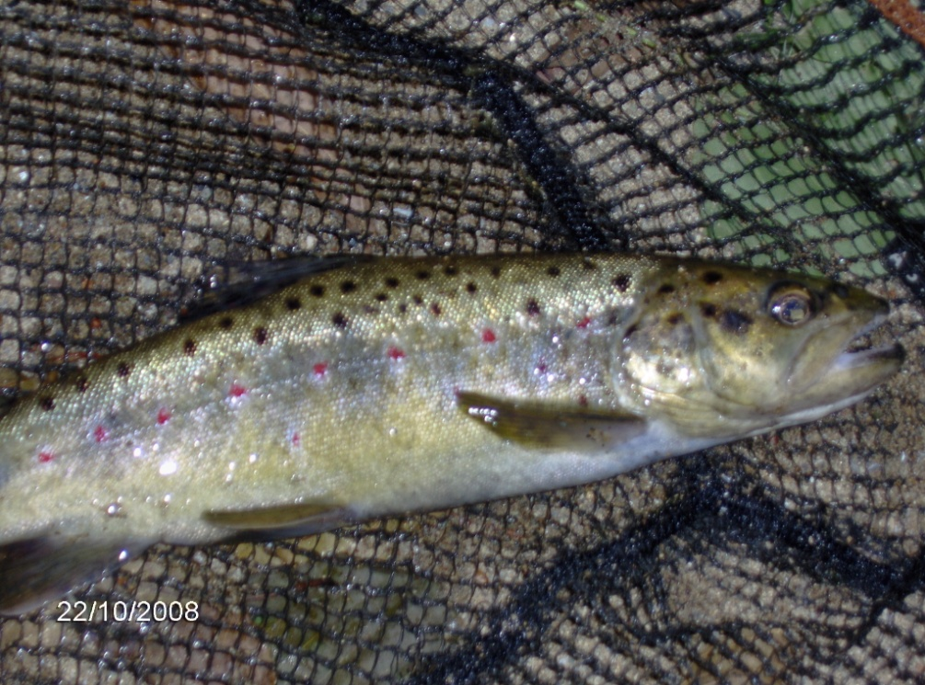
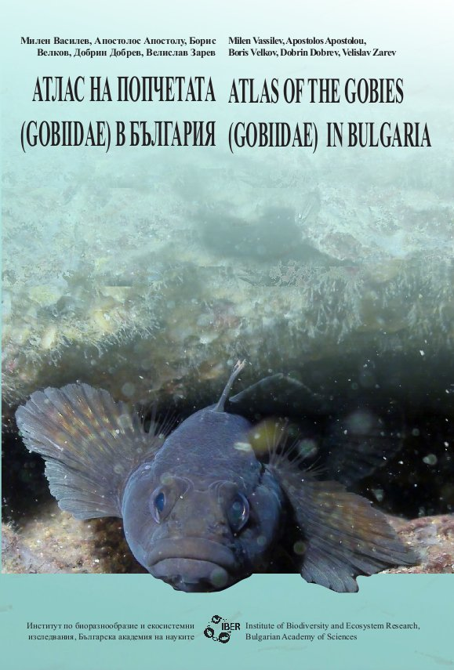
Division of Ichthyology & Fish Resources
Research Groups
Ecology & Dynamics of Fish Communities
Fish Biodiversity & Resources
Research Priorities
Species content, structure and dynamics of fish communities;
Taxonomical problems of Bulgarian fish fauna; population structure of the model fish species;
Inventory and assessment of fish resources; space distribution and population behavior of fish species of economic/human interest;
Economic potential of fish in freshwater bodies, both native and artificial/modified;
Ecological classification of water bodies by means of ichthyological parameters.

Slide 5
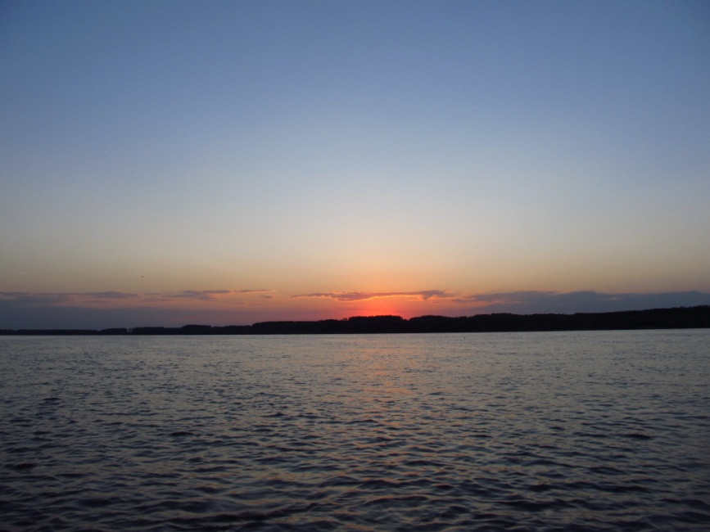
Implementing WFD 2000/60/EEC: selection of metrics; reference sites & conditions; water bodies’ ecological classification of both native & artificial water bodies; bio(eco)-monitoring …
Photo: Mila Alexandrova

Slide 6
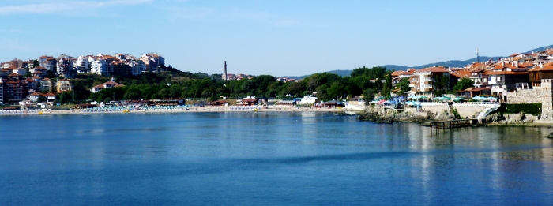
Division of Functional Ecology & Bio-Resources of Marine and Coastal Ecosystems
Research Priorities
Research on fate and effects of pollutants in coastal marine ecosystems;
Assessment of ecological status of species and habitats within protected marine & coastal water bodies and wetlands.

Slide 7
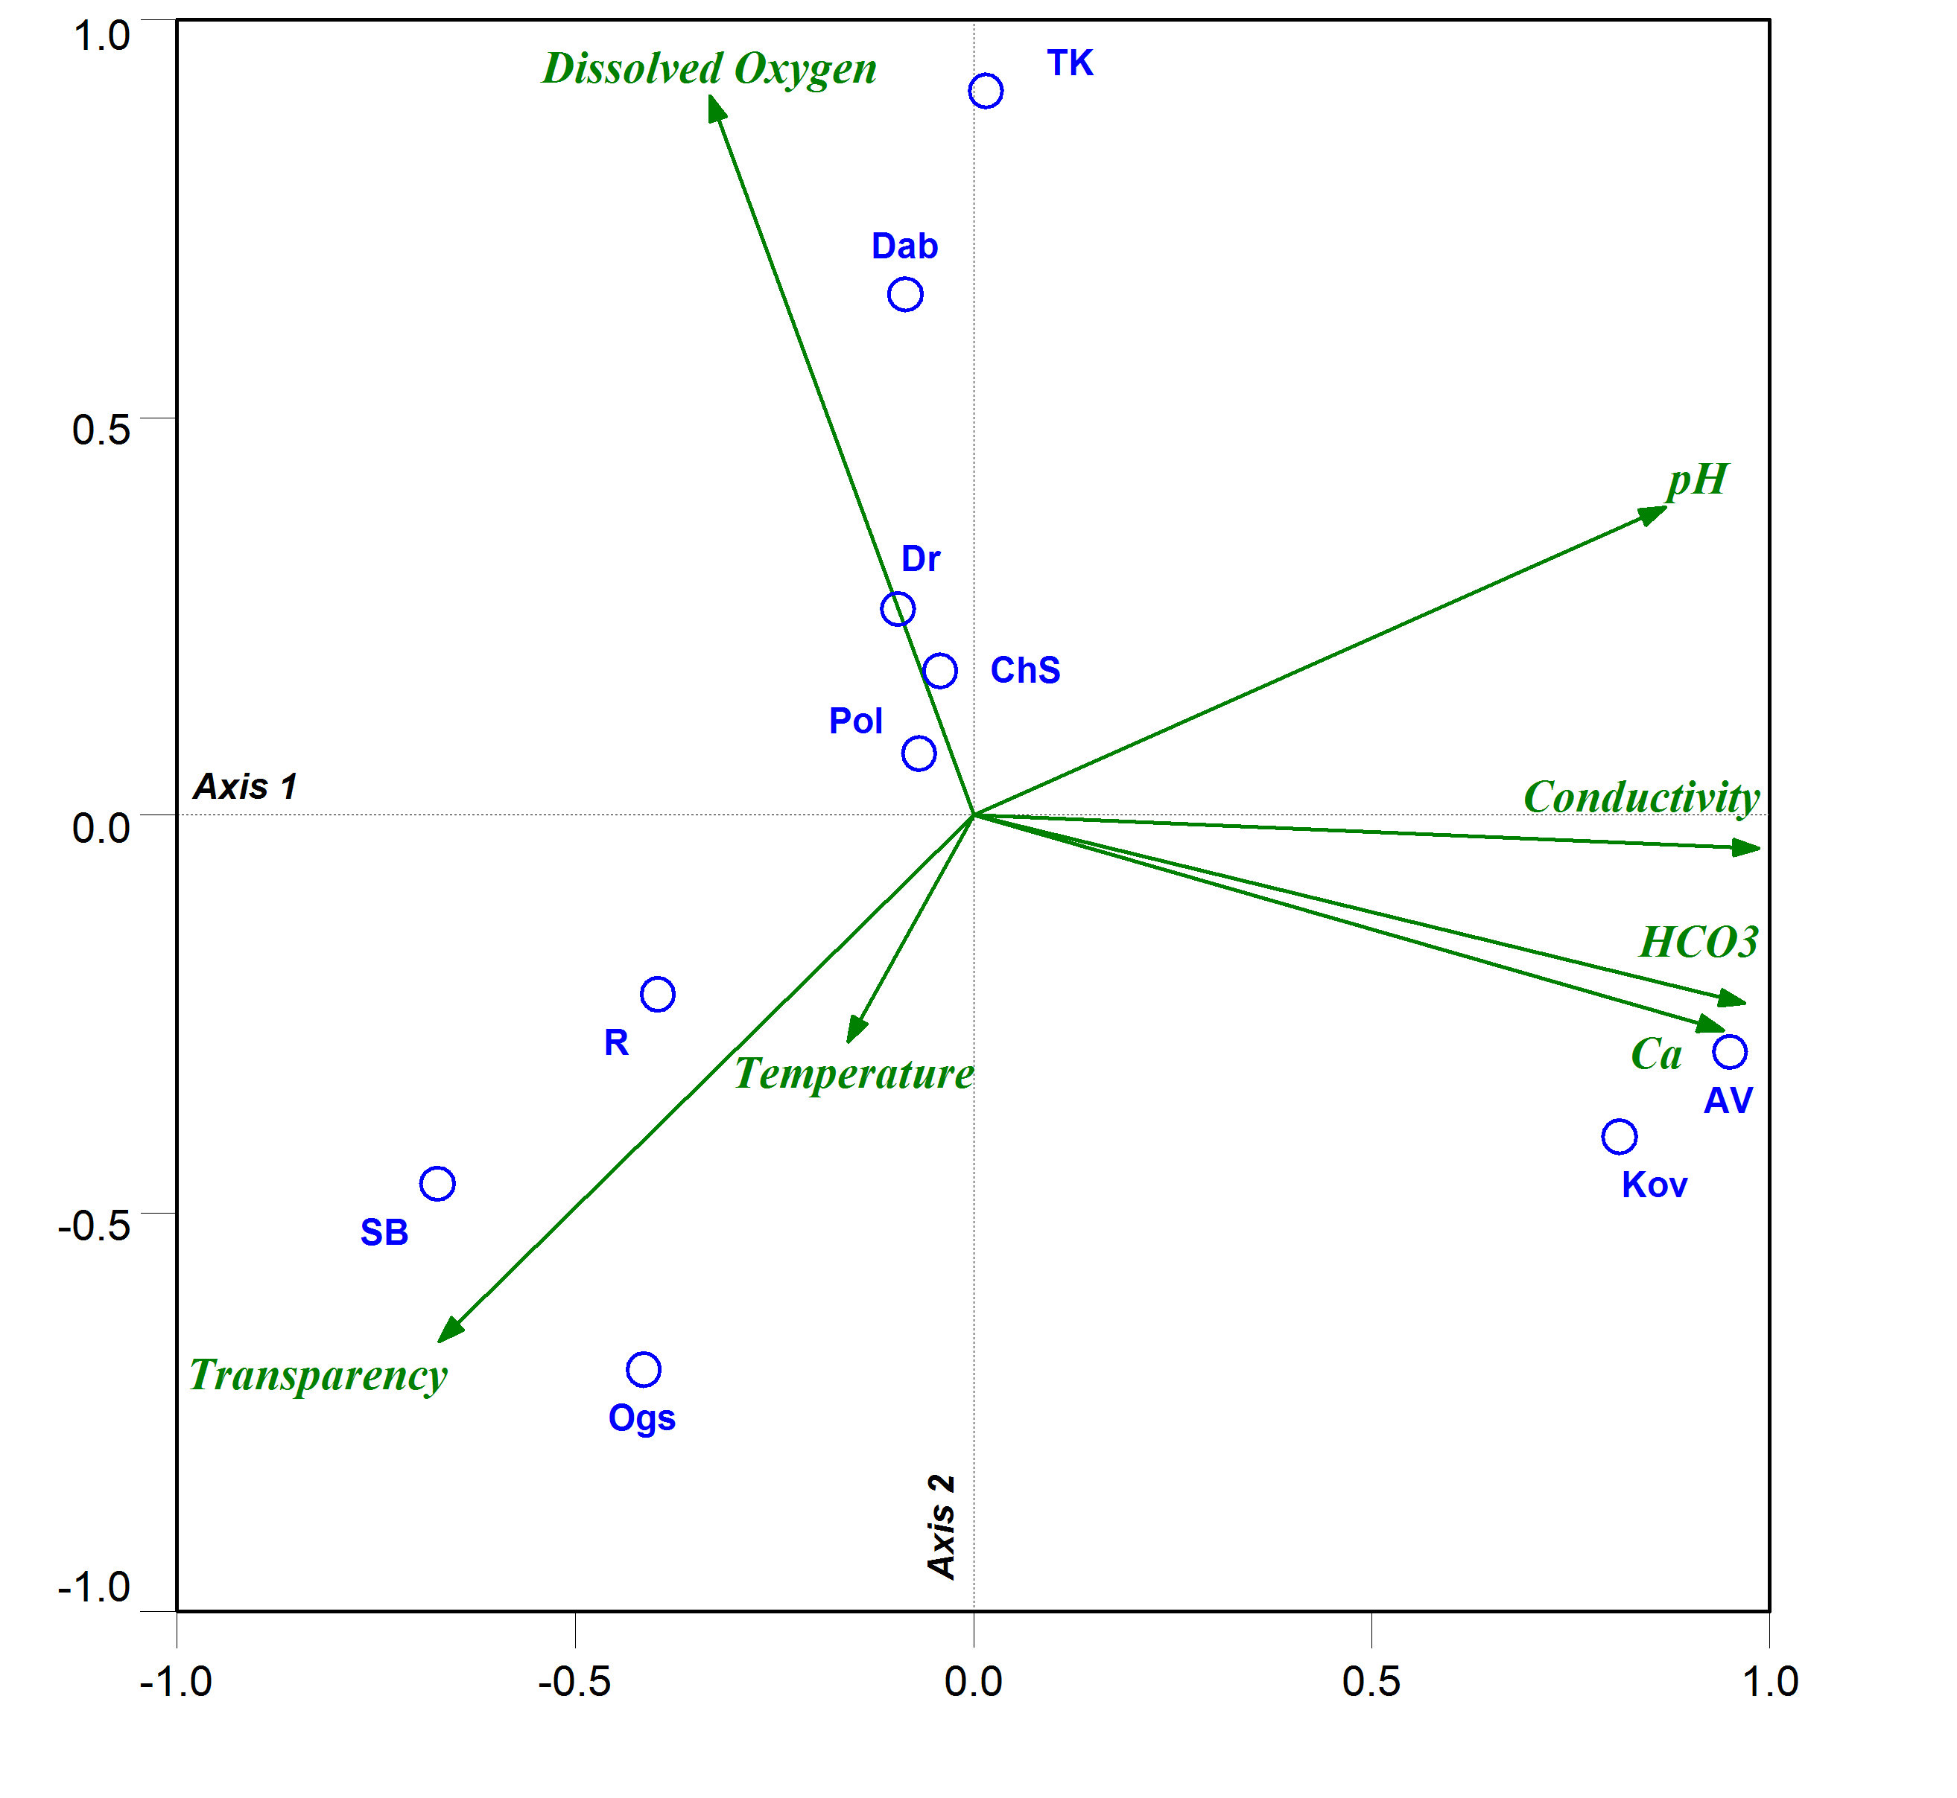
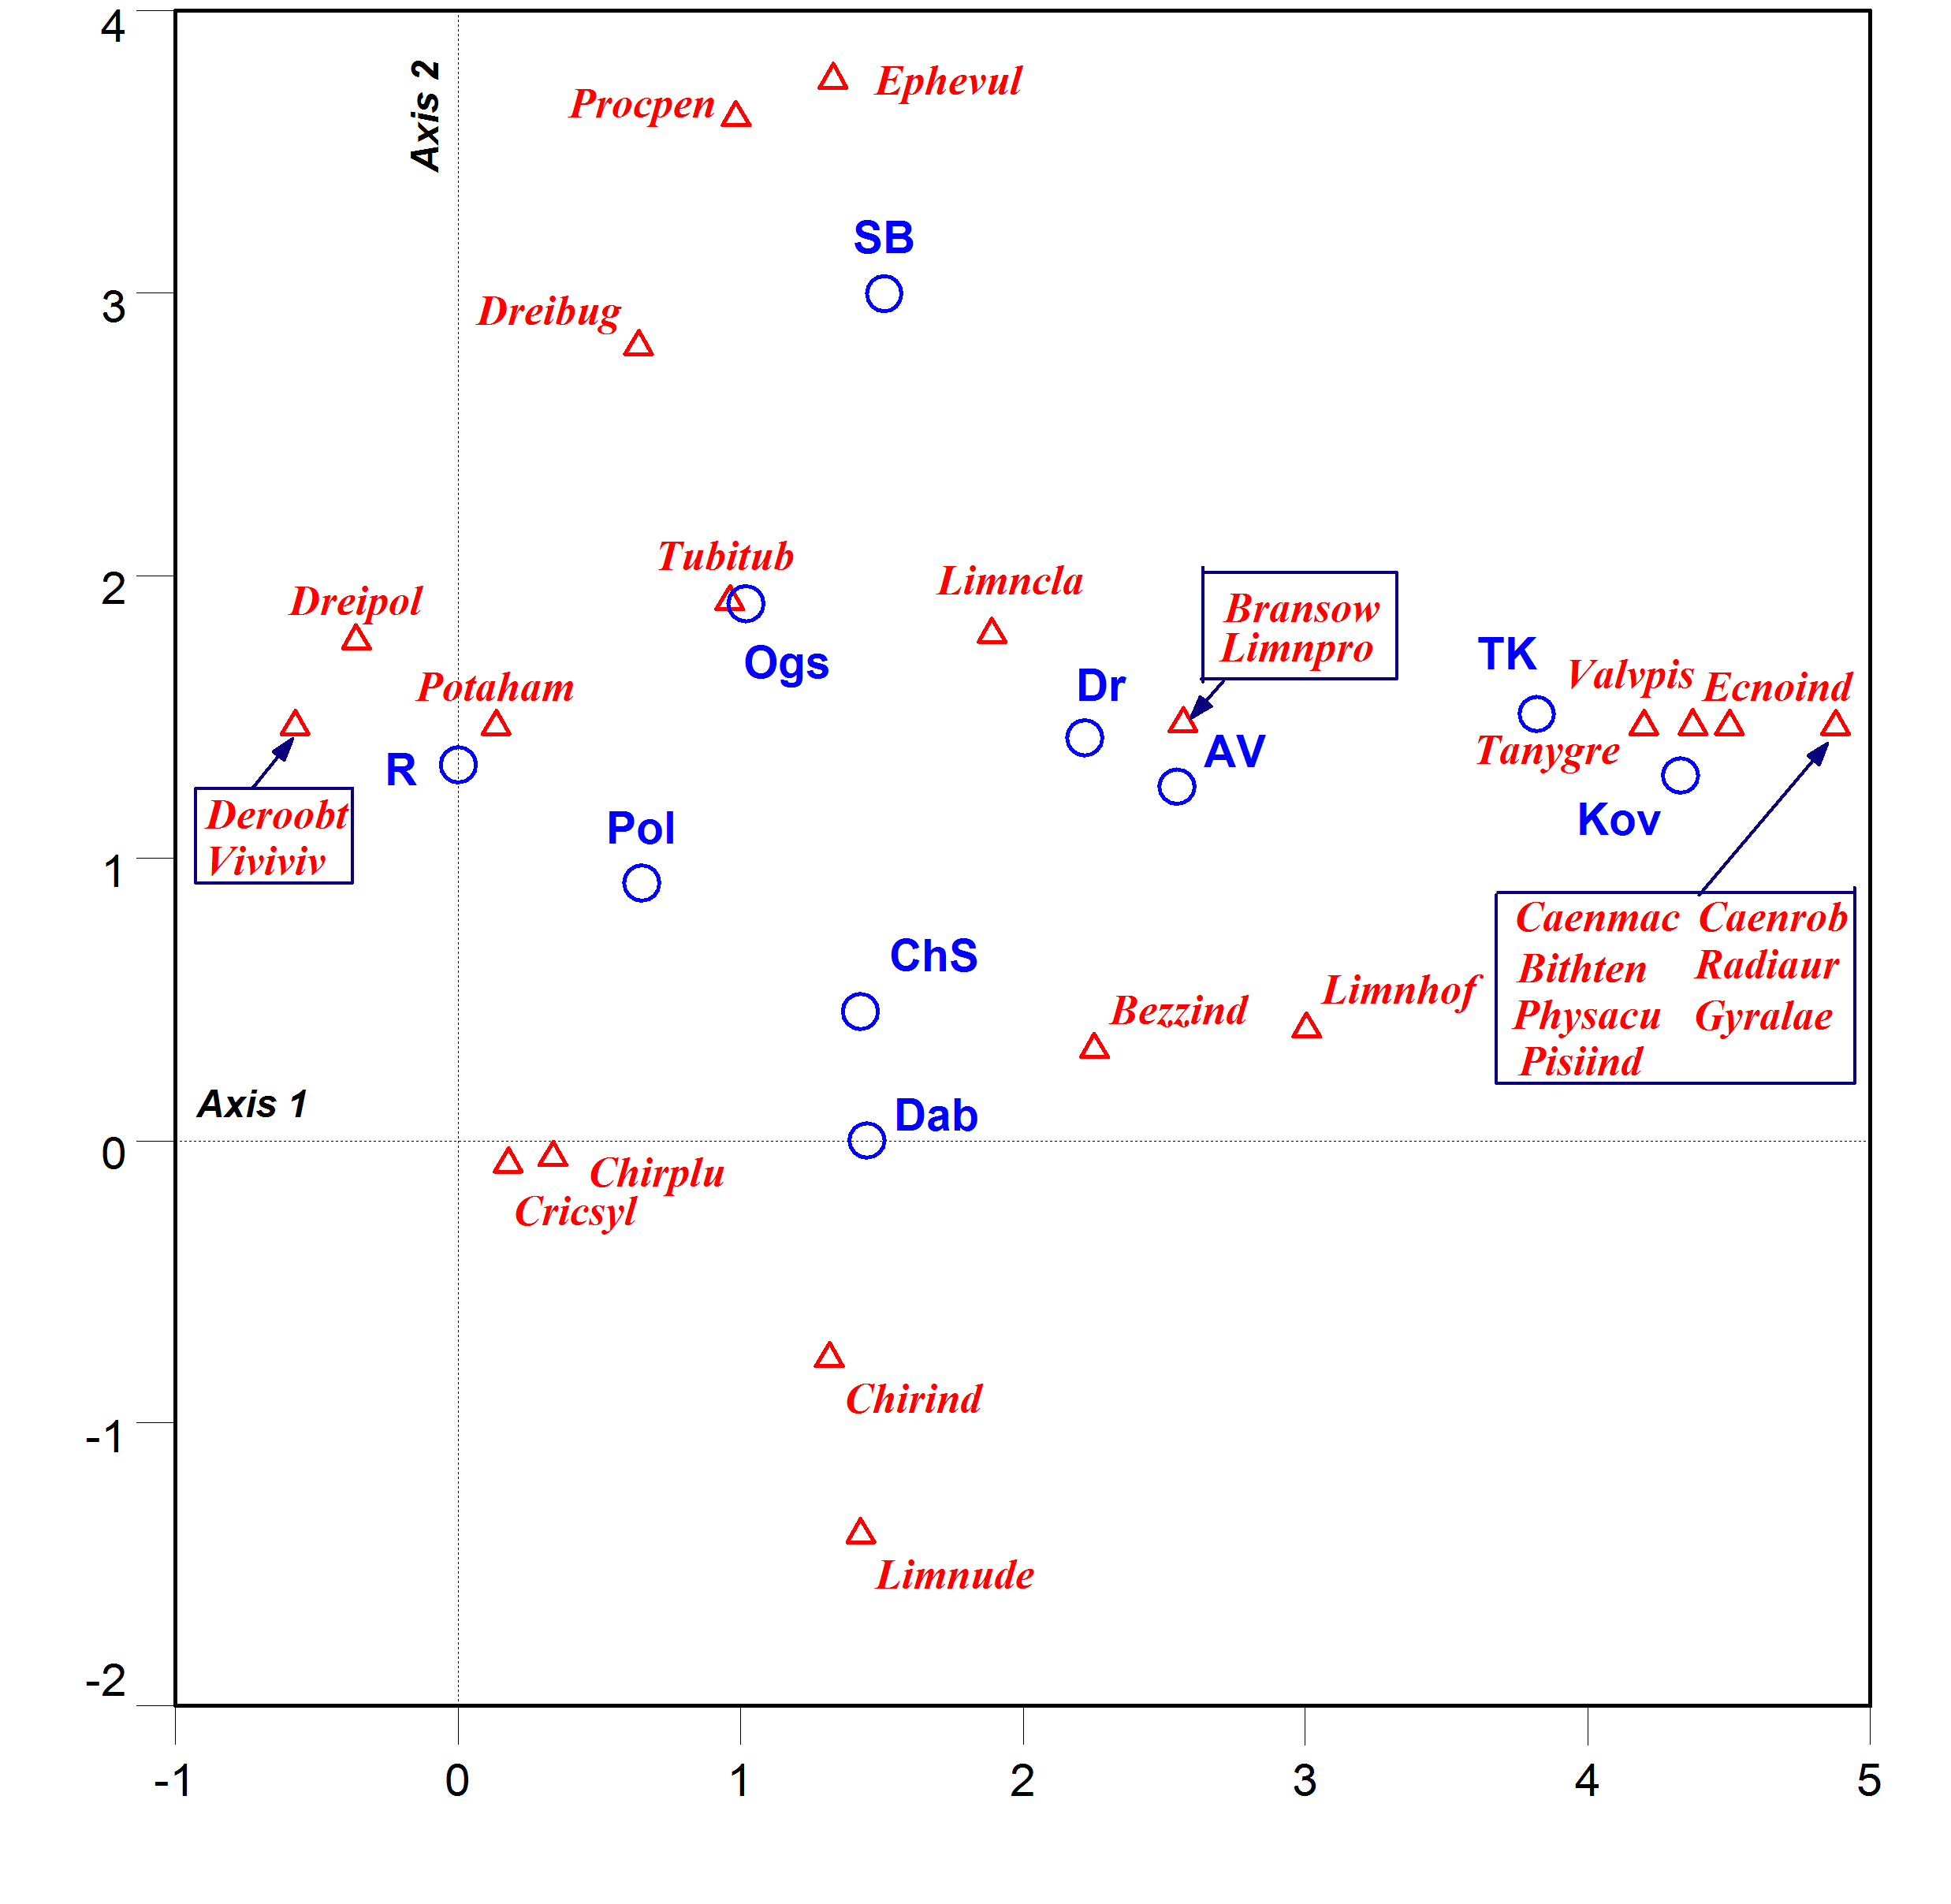
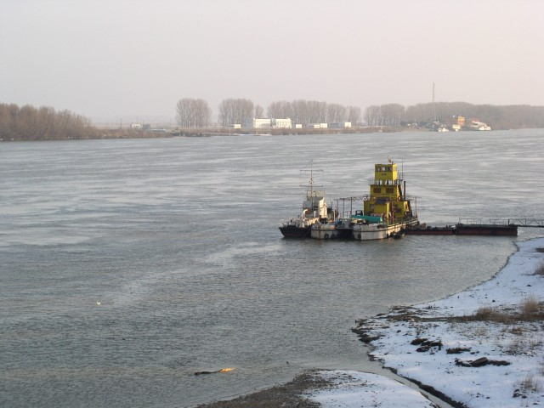
Modelling in DAE
Trivial numerical statistical modeling
Detrended Correspondence Analysis (DCA) ordination biplot (λ₁ = 0.784; λ₂ = 0.378) of macrozoobenthos data from ten of the studied reservoirs.
Principal Component Analysis (PCA) correlation biplot diagram based on PCA(λ1 = 0.591; λ2 = 0.231) of seven physical-chemical variables from 10 of the studied reservoirs.

Slide 8
QR-model fragment “Biological oxygen flux”

Slide 9

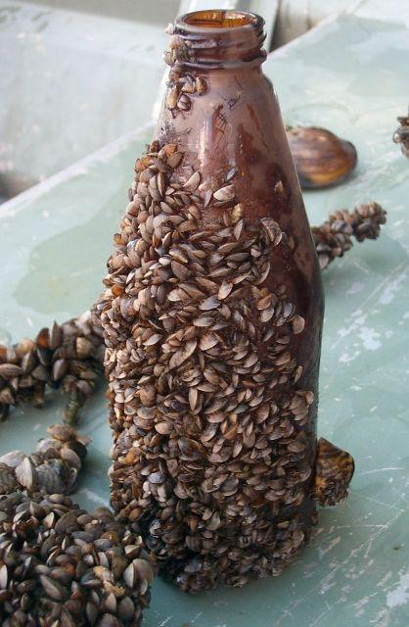
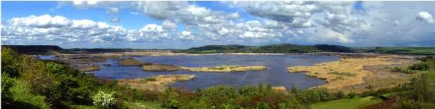
In brief:
DAE is currently a well organized scientific (R & D) body in 3 sections + 2 field stations (Srebarna Lake/Danube River and Sozopol/Black Sea) with permanent staff; competence in studying and development of methods, techniques and metrics for ecological classification & (bio)monitoring of ecological status and ecosystems’ goods and services as well in water bodies in all categories and types of rivers, lakes/ reservoirs, transitional/brackish and coastal marine waters.
Basic scientific partner of the MOEW, MRDW, MEET, MA, MH, etc.
Implementing projects financed by 5th, 6th and 7th EC FPRD such as NATURNET_REDIME, DYNALEARN, WETLANET, CEBDER, COCCONET, PERSEUS, etc.
Photo: Ivan Yanchev

Slide 10
Within the frames of EEA, we offer our partnership in the Programme BG02 «Integrated marine and inland water management» the following R & D projects/activities as follows:
BG02.1: Integrated management of marine and inland water management -
Activity: Further development of an integrated information system with biological/ ecological criteria, methods and metrics/descriptors, incl. functional parameters of marine biological quality elements, both species and communities…
BG02.2: Improved monitoring of marine waters –
Activity: paralleling of the biological, hydrological and hydrochemical data/info streams, requiring institutional coordination...
Activity: high-resolution mapping and monitoring of the ecological status of benthic/ bottom habitats in coastal marine ecosystems, especially marine habitats 1110 ,1170…
BG02.3: Increased capacity for assessing and predicting ecological (environmental) status in marine and inland waters-
Activity: development and introduction of methods for measuring/determination of priority substance in marine waters and sediments (such as organo-phosphate and/or organo-chlorine pesticides, polycyclic hydro-carbons, etc.
Activity: development of assessment tools and modeling for forecasting the ecological status of marine waters in the sector/segment «biota», incl. marine bio-resources…

Slide 11
Current priorities related to the European Research Area (ERA) we are offering a research partnership on following topics:
Climate changes and problems of the ecological classification of surface waters, such as referent conditions/sites; changes in species and communities structure and their spatial distribution, etc.
Aegean/Southern rivers as corridors for invasion and spreading of invasive alien aquatic species;
Assessment of ecosystem services and ecosystem modeling of marine and inland water bodies and their biological diversity;
Biodiversity protection/conservation and sustainable practices in ecosystema goods and services management in riparian and coastal wetlands, in temporary/drying small rivers and pools, etc.
Contacts:
Prof Dr Yordan UZUNOV, Head of the DAE and of the Freshwater Section
Yordan.Uzunov@iber.bas.bg; uzunov@ecolab.bas.bg
Prof Dr Georgy DASKALOV, Head of the Marine Ecology Section
daskalov@yahoo.com
Assoc. Prof Dr Luchezar PEHLIVANOV, IBER Deputy-Director, Head of the Fish Section
lzp@abv.bg

Slide 12
THANK YOU
FOR YOUR KIND ATTENTION

