Slide 1
EPH structure, projects and project ideas
Environment and Public Health Office
Kjos region, SW-Iceland
www.eftirlit.is/en
Sofia, June 26th. 2014
Thorsteinn Narfason, MSc
Manager
Notes:
My name is Þorsteinn Narfason and I am a director for the Environmental and Public health office for Kjos region located in SW-Iceland. I made a short introduction about my lecture, which you have as printouts with some additional information
So now I start directly on the topic. The title is a reference to the objective of maintaining the water quality of groundwater for the capital area for consumption in the future without a treatment.

Slide 2
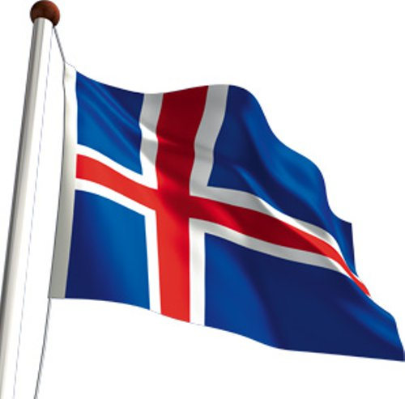
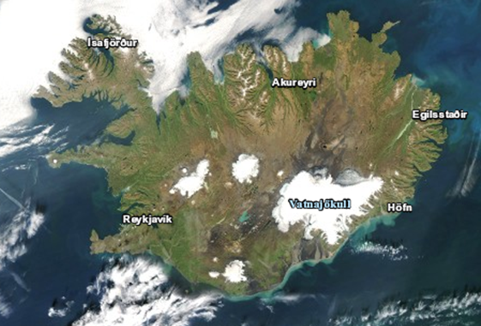
Location

Slide 3
The rebublic of Iceland
Population 325.671
103.000 km²
2/3 live in the capital area
74 communites
1 waterbody, 4 water districts (WFD)

Slide 4
Structure of Environm. and Public Health office
Iceland is divided into 10 municipal control districts
Each supervised with a independent authority board of public health.
Its role is to promote public welfare by helping to ensure a healthy environment, and safe consumer goods.
This is brought on with regular control in operating companies, monitoring and education.

Slide 5
Structure
The organization and structure of the EPH offices is based on provisions in the environmental legislation.
Environment and food Agency of Iceland is responsible for coordination of EPH offices related to environmental protection
Ministry for the Environment and natural resources is responsible for legislation on environmental protection

Slide 6
EPH office projects
Evaluating water quality in rivers and lakes since 1999
Monitoring of the coastline since 2004
Biological monitoring of lakes
Monitoring changes
Tracking soures
Monitoring drinking water quality
Protection of drinking water protection area

Slide 7
Project ideas
Meetings to exchange information on watershed issues
Make guidelines for analysis methods and decisionmaking
Improve watershed management plan methodology
Improving pollution prevention control

Slide 8
ffffff
The nature does not protect it self for human acivities
Action is needed to preserve the pristine sides and clean the polluted
The river Laxa
N-Iceland
Ramsar side

