Slide 1
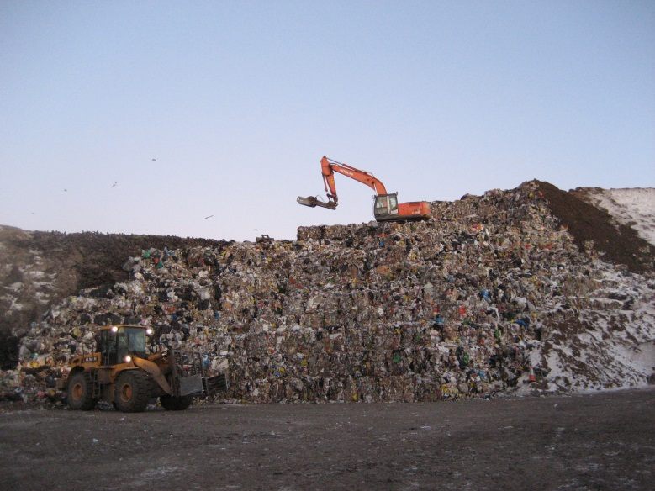
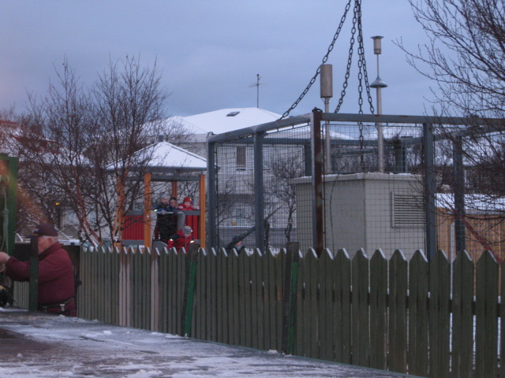
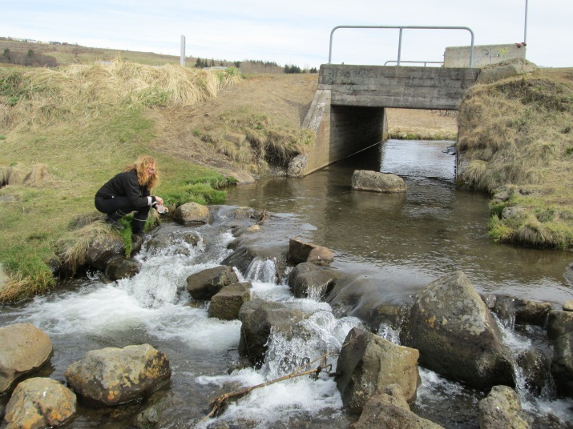
Reykjavik´s Public Health Authority

Slide 2
The Public Health Authority
17 public health officers work at the authority, 2 department managers and a director
All are required to have finished a university education within the fields of natural science or health science and must have a licence as public health officers.
The Authority is responsible for issuing licences for companies, monitoring, pollution control and protection of the environment.

Slide 3
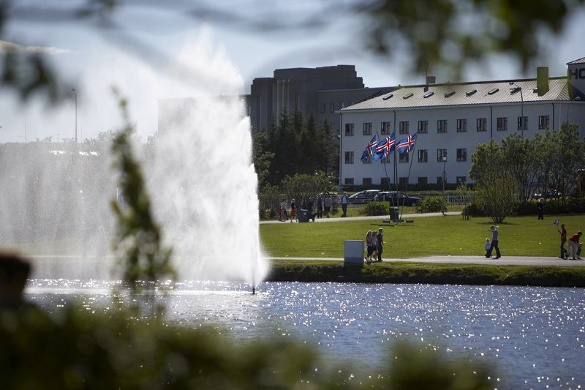
Monitoring of Reykjavik´s coastline, rivers and lakes

Slide 4
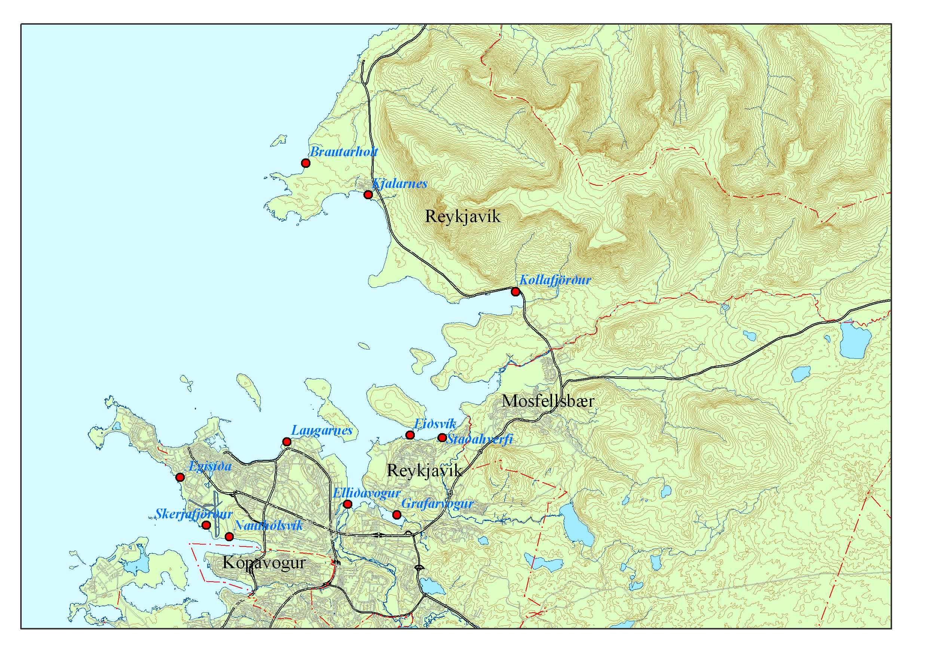
11 points at the coastline of Reykjavík are monitored since 2003.
Measurements of E.coli and Enterococci

Slide 5
Monitoring of Reykjavik´s coastline 2003-2012
Notes:
¹ (>100 saurkólí/100ml sjó)
² Sýnatökustað við Grafarvog bætt við í júní 2006
³ Þrjú af tilvikunum rakin til dælingar á svínaskít í Brautarholti
⁴ Þrjú af tilvikunum rakin til veðurfars (þurrkatíð -> væta)
⁵ Öll tilvikin rakin til veðurfars (óveður)
⁶ Bæði tilvikin voru á sýnatökustað 11 í Grafarvogi. Annars vegar í júní en þá fór það 410 saurkólí og svo í 170 í október. Enterococcar bara yfir í júní en þá líka í 300. Veðrið þennan dag…Nokkuð mikil fjara á nokkrum sýnatökustöðum og var t.d. ekki hægt að taka sýni á stöð 11. Grafarvogur fyrr en um 20:30 og var sýnið geymt í kæli þar til farið var með það á rannsóknastofuna morguninn eftir. Eflaust hefði átt að endurtaka sýnatökuna. Var brák á voginum þegar komið og tekið sýni í október.

Slide 6
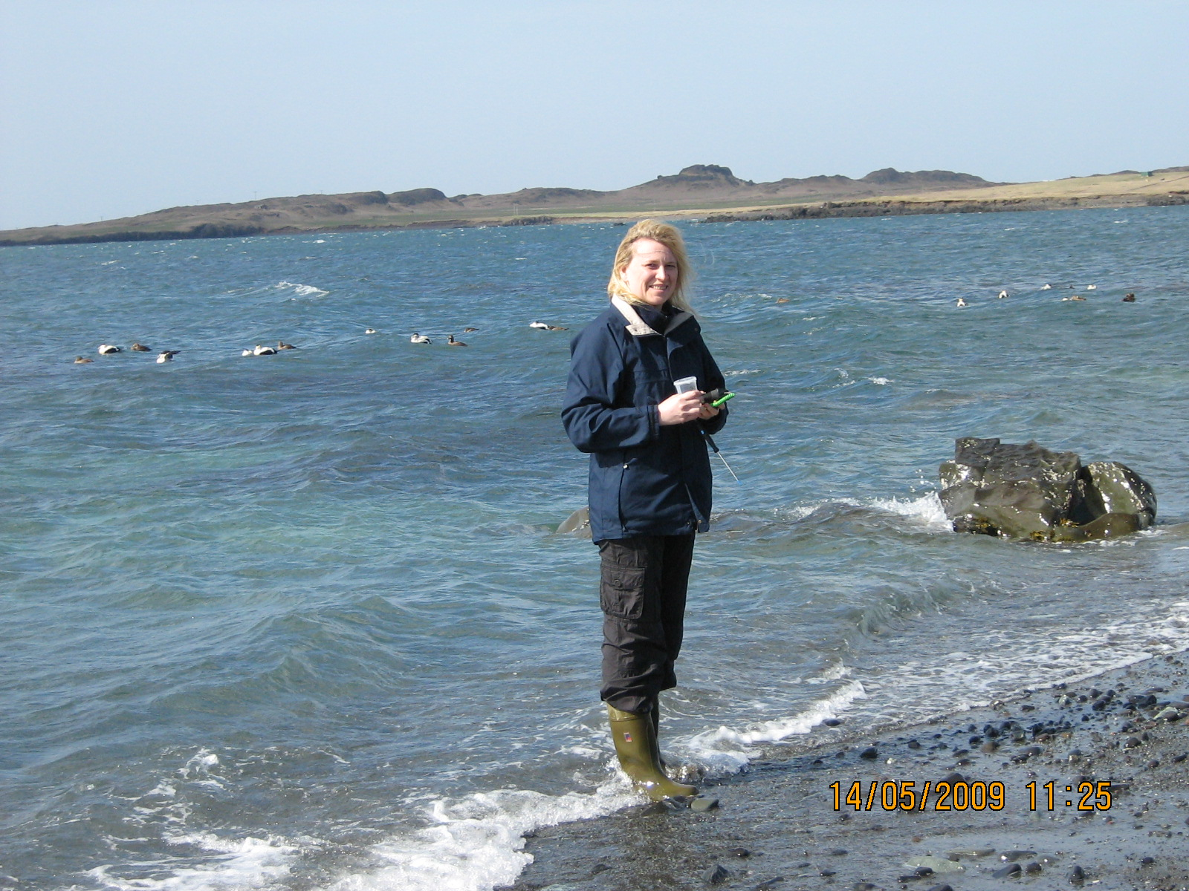
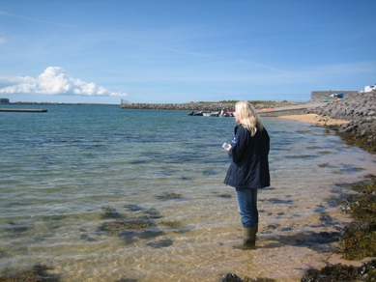

Slide 7
Rivers and lakes in Reykjavik have been monitored and water quality classified
4 lakes and 6 rivers have been classified in regards to water quality and are monitored regularly. Among variables mesured were fecal bactera, pH, conductivity, total carbon, nutrience status and heavy metals.
Over all results were rather positive but one lake is very polluted. The Public Health Authority is working on methods to improve water quality where necessary

Slide 8
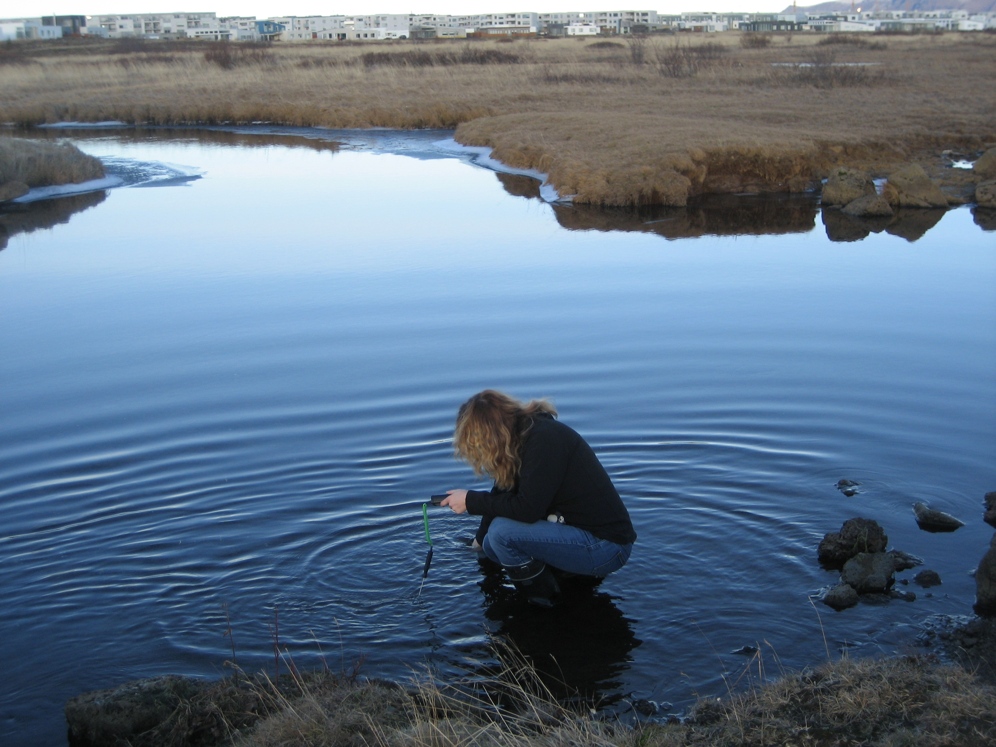

Slide 9
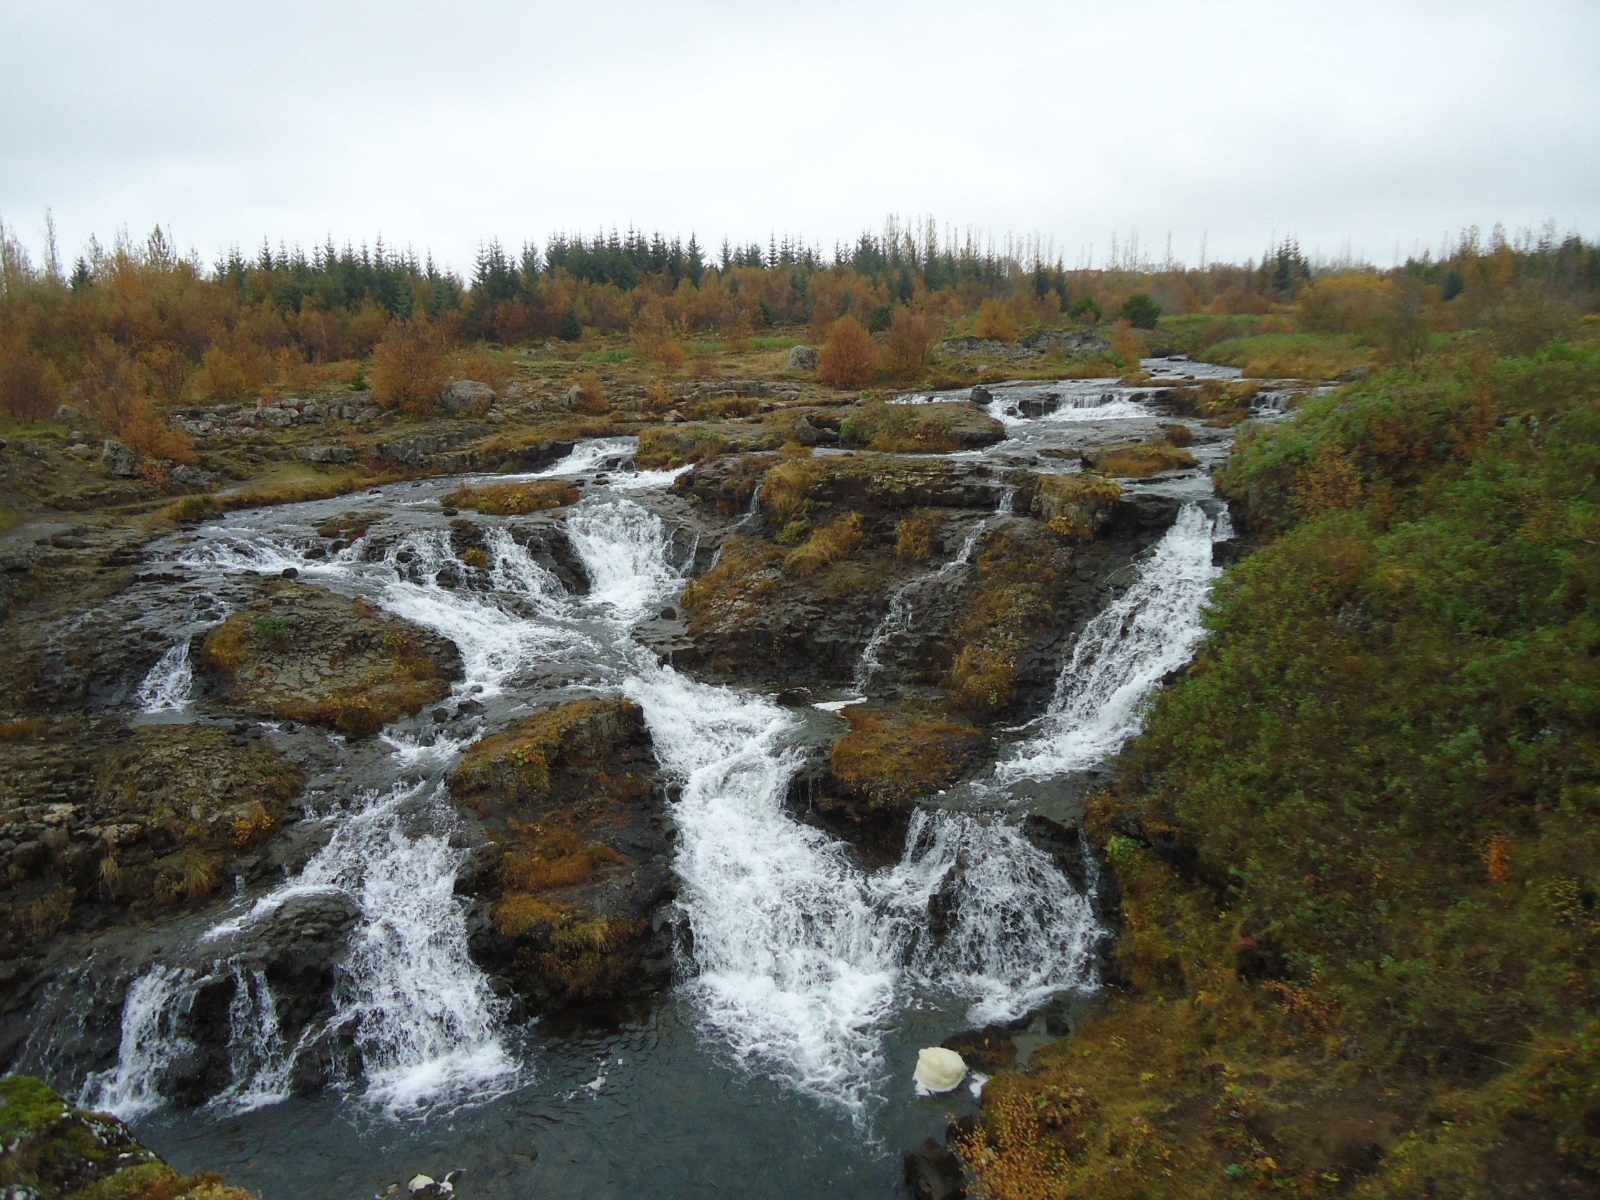

Slide 10
The ground water conservation area
The drinking water of Reykjavik´s population is entirely from groundwater resevoirs and does not need any treatment before consumption
Around 300 km2
The wells/boreholes are pink on the picture
Regular monitoring of the water level

Slide 11
Interest in projects
Monitoring of coastal marine waters
Management and improvement of inland waters

Slide 12

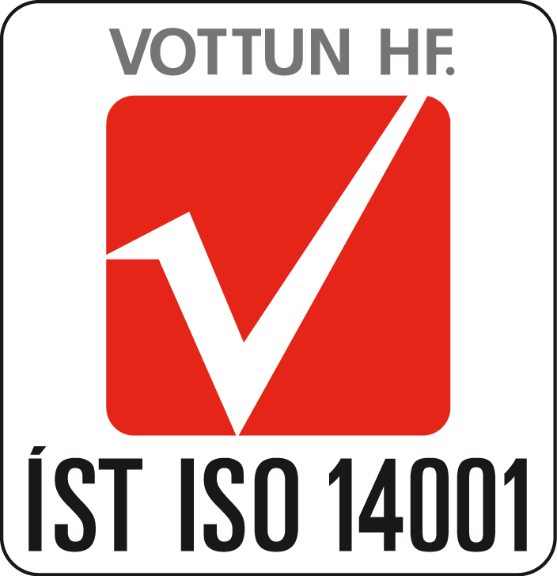

Websites
The webpace of Reykjavik´s Publich Health Authority
http://reykjavik.is/thjonusta/heilbrigdiseftirlitid (in icelandic, english website available later)
Application of Reykjavík city for the European Green Capital (the link Umsókn Reykjavíkurborgar)
http://reykjavikurborg.is/desktopdefault.aspx/tabid-3822/6631_view-3943/

